Slide 1
4 Pillars of OOP
Discussion: Have you started Practical 5? What are you learning so far?

Slide 2
Programming Paradigms
Programming Types
Procedural / Imperative
Functional
Object Oriented Programming (OOP)

Slide 3
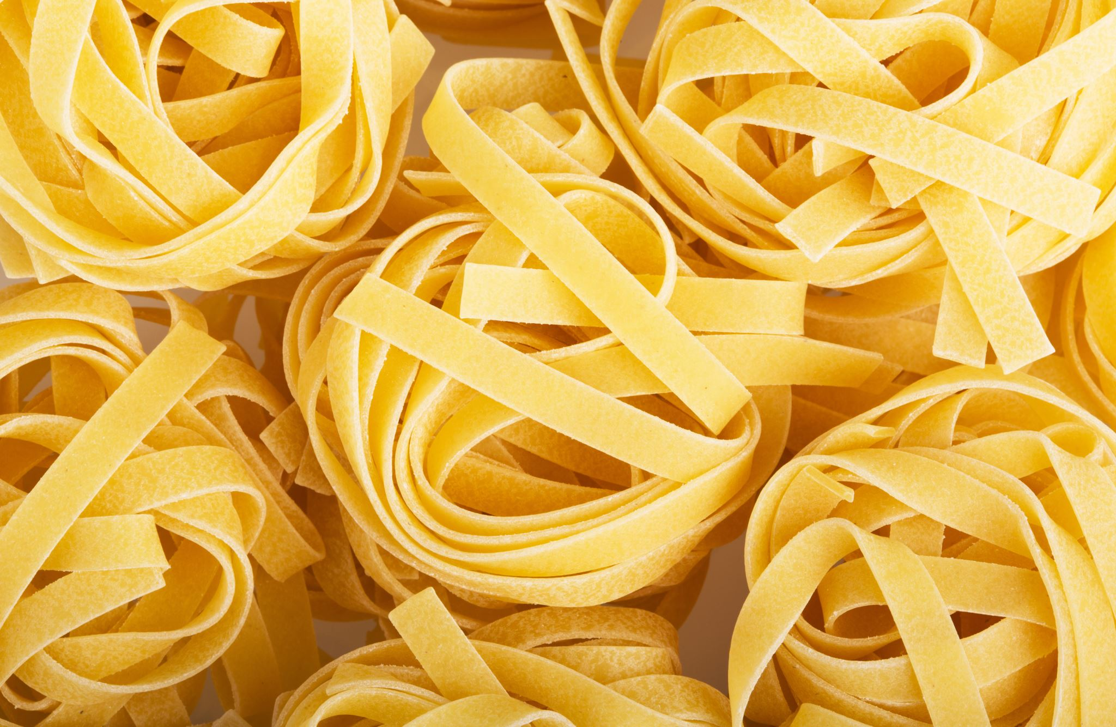
Procedural / Imperative
Procedural
The “traditional” programming (rarely used except for scripts)
functions/methods and properties (variables)
No organization beyond that, so methods call other methods directly
Produces large files and “spaghetti code” as the code base grows
Works well with
smaller applications
scripts

Slide 4

Functional
This Photo by Unknown Author is licensed under CC BY-SA
Functional
as name sounds – very function/method based
everything returns something!
common in languages such as python
downside – you end up passing more information as variables only exist in functions
this is often broken, and only true in the “strictest” sense
hard to follow if there isn’t a strict naming scheme of files
can be slower due to memory stack (recursion)
Works well with
math orientated applications (such as ML)
Easier testing paradigm, as every function needs to be self contained
Much of OOP is actually functional if following good coding rules

Slide 5

Object Oriented Programming
OOP
Combines procedural and functional
Makes use of methods/functions
makes use of properties
but – everything must follow these four rules / pillars
Four Pillars of OOP
Encapsulation
Abstraction
Inheritance
Polymorphism
Note: this is a common technical interview question!

Slide 6
Encapsulation
Discussion, why would this
make testing easier?
Wrapping data under a “single self-contained unit”
Objects
The process of encapsulation says information is stored in
Objects
Self-contained
Only way to access data is through Methods
Every variable is private or protected
Accessor/Mutator methods
Anything done in the object should not affect other objects properties (variables) directly
You have been practicing this for a while.
The why you “interface” with a class then is very carefully defined!
For P5, this is why we didn’t list your private variables in the writeup!

Slide 7
Abstraction
Discussion: can you think of
other examples of this?
Only show the ”relevant” data, and “hide” unnecessary details
A car is made up of many encapsulated components
but we often don’t care about those components!
we simply want the car to work with our interface
You practice this by :
Writing code in layers
View Layer was our interface
Layers upon layers, with carefully defined interfaces
but the objects rely on each other
Discussion: How are abstract classes or interfaces related to this idea?

Slide 8
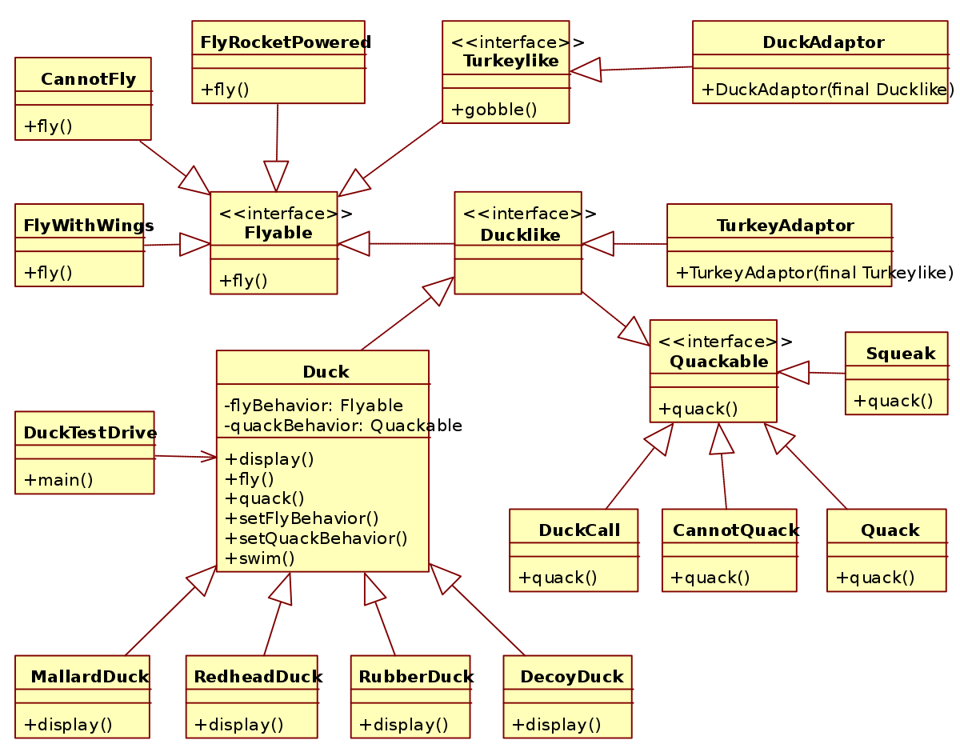
Inheritance
A class can acquire the properties and methods of another class
The goal
Provides reusability
Only one class has a unique feature, the rest share features
parents contain the shared features (Base class)
children have the unique feature (derived class)
Keep your code D.R.Y.
This Photo by Unknown Author is licensed under CC BY-SA
Discussion: What are some ways in your past assignments would have benefited from inheritance?

Slide 9
Polymorphism
Discussion – why is this advantageous?
Greek – poly means many
morphs – means forms
Polymorphism means objects have many forms
Children look like Parents
but overwritten – means the ”most specific” version is called
common overwritten methods
.equals(Object obj)
.toString()
.hashCode()
Why is Object important here, instead of Class name?
You will learn hashCode in the future

Slide 10
Discussion Item
Discussion: Following these four pillars – which way is more “correct”
int myMethod(List<String> list) {
return list.size(); // yes pointless method
} int myMethod(ArrayList<String> list) {
return list.size();
}
Can you think of a case where the other one is more correct?
.removeRange(int, int) – this is an ArrayList specific method! If you use it, the parameter needs to be ArrayList

Slide 11
P5 Testing Suggestions
Encapsulation
Every object can have their own main for testing
The TA will show you an example of how to do this
You do not need a ProcessArgs inner class. (Like P3 and P4)
Just easier to handle them in your Main.main
The inner class is a more robust way to do it, but not needed for this one
Keep it Simple!!!
Start Early – it is long
Keep it simple!!!

Slide 12
Knowledge Checks?
Questions about P5??
Only three weeks left!
After we work on the webpage, make sure to ask the TAs to walk you through any knowledge checks or lab methods!

